Slide 1

Introduction to NMR
4th NMR Meets Biology Meeting
Konstantin Ivanov (Novosibirsk, Russia)
Khajuraho, India, 16-21 December 2018

Slide 2
Outline
Angular moment (spin) and magnetic moment;
Magnetic resonance phenomenon;
Bloch equations;
NMR pulses;
FID, Fourier transform, 1D-NMR, 2D-NMR;
T₁ and T₂ relaxation.

Slide 3
Angular momentum and magnetic moment
In NMR we deal with spin magnetism. What is ‘spin’?
Charged nucleus (or electron) is spinning:
there is angular momentum (spin) and magnetic moment
attention: this is a simple view, which is not (entirely) correct
The electric current for a charged
particle moving around
The magnetic moment is
q
So, μ is proportional to a.m.; when a.m. is measured in ħ units
Quantum mechanics: this is not entirely correct (we are wrong by the g-factor)!

Slide 4
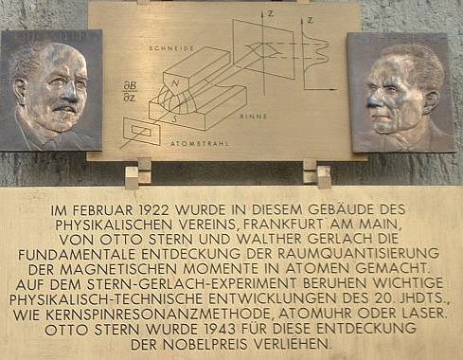
Angular momentum and magnetic moment
Furthermore, QM tells us that S is quantized: angular moment measured in ħ units cannot be an arbitrary number
Stern-Gerlach experiment:
The beam of particles is deflected by inhomogeneous field
Reason: intrinsic magnetic moment (spin) of particles
In contrast to the classical expectation the distribution of the μ-vector is not continuous!
Spin is quantized

Slide 5
Angular momentum and magnetic moment
Furthermore, QM tells us that S is quantized: angular moment measured in ħ units cannot be an arbitrary number
S is integer (0, 1, 2, …) or half-integer (1/2, 3/2, 5/2, …) and |S|={S(S+1)}^{1/2}
Projection of S onto any axis in space varies in steps of 1 from – S to S
Spin-½ particle (¹H, ¹³C, ¹⁵N, ¹⁹F, ³¹P…): possible projections are ±1/2
Spin-1 particle: possible projections are –1, 0, 1
When discussing spin-½ particles we can use a simplification (and forget about QM): spin magnetization is a classical vector in the 3D-space, which is changing by moving in external fields and due to spin relaxation
As we can see from the density matrix description, this is correct (but only for two-level systems!): fictitious spin description

Slide 6
Magnetic resonance: classical viewpoint
Motion of a classical magnetic moment in a constant magnetic field B₀
Magnetic moment is
γ_{N} is the gyromagnetic ratio (or magnetogyric ratio)
We obtain a torque:
These equations tell us that:
|J|=const; the J-vector is rotating about B₀ at a frequency ω₀=|γ_{N}|B₀
This is precession of magnetic moment
The direction is given by the γ_{N} sign
What happens to the magnetic moment if we apply an oscillating field?
Typically this field is much weaker than B₀: it does nothing except for some special cases
B₀
torque
μ, J

Slide 7
Magnetic resonance: classical viewpoint
Let us apply an oscillating field perpendicular to B₀: B┴=2B₁cos(ωt)
To account for the effect of this field we can go
to the rotating frame:
Linear polarized field = 2 circularly polarized fields: two vectors rotating with the same speed in opposite directions
At high ω the vector, which rotates with double frequency can be neglected. This is (usually) Ok for the description of resonance
z=z´
If a is a constant vector in the RF, in the LF we obtain
y
ωt
y´
x´
x
y
y´
Lab frame
Rot. frame
x
x´

Slide 8
Magnetic resonance: classical viewpoint
What happens to the transverse field:
Linear polarized field = 2 circularly polarized fields: two vectors rotating with the same speed in opposite directions
Graphical representation in both frames:
At high ω the vector, which rotates with double frequency can be neglected. The other vector does not move. This is (usually) Ok for the description of resonance
y
y´
Lab frame
Rot. frame
x
x´

Slide 9
Magnetic resonance: classical viewpoint
Equation of motion in the rotating frame
By taking derivative we obtain:
Equation of motion in the rotating frame
Still the same equation but the new field equals to
Superposition of the new B₀ and B₁-fields gives a constant effective field B_{eff}
Here the components of J change and the basis vectors {i, j, k} also change with time
Here δ/δt is the time derivative in the rotating frame

Slide 10
Magnetic resonance: classical viewpoint
The effective field is the following vector
Precession frequency is
If ω=ω₀ the precession axis is the x-axis => variation of J_{z} reaches its maximum. This variation rapidly decays with ω going to zero at |ω–ω₀|>>ω₁
Resonance condition: ω = (free precession frequency). Weak B₁ is important!
Frequency range (given by γ_{N}): radio-frequency, i.e., 300 MHz for ¹H @ 7 Tesla
Resonance width is given by condition |ω–ω₀|≈ω₁. If ω₁>>|ω–ω₀| the effective field is nearly parallel to the x-axis – we are at resonance!
At resonance the precession frequency is ω₁. If we switch on the resonant oscillating field for time period of τ_{p} the flip angle of magnetization is
z
B_{eff}
B₀–ω/|γ_{Ν} |
x´
B₁

Slide 11
Magnetic resonance: simplified quantum viewpoint
The energy of interaction of the spin with an external field is
If B₀ is parallel to the Z-axis
The degeneracy of the spin levels is lifted
Fermi’ golden rule tells us that there is a resonance when ω=ω₀
E=|γ_{N}|B₀/2
Periodic perturbation
Absence of MF
E= –|γ_{N}|B₀/2
Presence of MF

Slide 12
Macroscopic spin magnetization
Up to now we discussed a single spin ½, which is never the case in NMR
At thermal equilibrium we have almost the same amount of spins pointing up and down: the energy gap between the spin levels is much smaller than kT
We work with net magnetization of all spins; at equilibrium this is a vector parallel to B₀ (longitudinal magnetization)
However, we do not measure the longitudinal component, but rotate M with RF pulses to obtain transverse magnetization and measure the signal from M┴
B₀
Nuclear
paramagnetism:
the induced field is parallel to B₀

Slide 13
T₁ and T₂ relaxation
Relaxation is a process, which brings a system to thermal equilibrium. Physical reason: fluctuating interaction of spins with molecular surrounding
For spins this means that M_{z}=M||=M_{eq} and M┴=0
There are two processes, which are responsible for relaxation
  Longitudinal, T₁, relaxation: M_{eq} is reached at t~T₁:
  Transverse, T₂, relaxation: magnetization decays to zero at t~T₂:
Generally, T₁≠T₂.
Taking all that into account we can write down equations describing precession+relaxation

Slide 14
Bloch equations and FID
We write down equations describing precession and add relaxation terms
Now we can describe simplest NMR experiments. Example:
M_{z} is flipped by 90 degrees by a resonant RF-pulse: φ=ω₁τ_{p}=π/2
It starts rotating about the z-axis and decaying with T₂
We detect M_{y} (or M_{x}) and collect the Free Induction Decay (FID)
z
ω₁τ_{p}
1
How to obtain the spectrum?
y
0
t
-1
Free Induction Decay
x

Slide 15

Fourier Transform NMR
How do we obtain the spectrum – by performing the Fourier transform
Some examples
∞
∫
g(ω) = f(t) cos(ωt)dt
0
Fourier transform
1
0
t
ω
-1
time domain f(t)
frequency domain g(ω)
FT
δ-function, single freq.
FT
Lorentzian at zero freq.
FT
Lorentzian at ω₀ freq.

Slide 16
Fourier Transform NMR
How do we obtain the spectrum – by performing the Fourier transform
Some examples
FT can be performed in a fast and efficient way (FFT algorithm)
∞
∫
g(ω) = f(t) cos(ωt)dt
0
Fourier transform
1
0
t
ω
-1
time domain f(t)
frequency domain g(ω)
FT
IFT
Inverse FT gives g(ω) from the FID signal
Widths of g(ω) and FID(t) are inter-related: δt~1/δω

Slide 17
Fourier Transform NMR
A few words about pulses
RF-synthesizer produces a signal oscillating at the spectrometer reference frequency ω_{ref}:
Gating: the signal passes through the transmitter only for certain periods of time => we obtain an RF-pulse
Parameters of the pulse:
frequency ω_{ref}
strength B₁ and duration τ_{p} provide the flip angle φ = |γ_{N}|B₁τ_{p} = ω₁τ_{p}
phase: ψ=0 (x-pulse), ψ=π/2 (y-pulse), ψ=π (–x-pulse), ψ=3π/2 (–y-pulse)
The phase is time-dependent and can be precisely controlled

Slide 18
Fourier Transform NMR
A few words about FID detection
We measure the signal comparing it to the reference frequency ω_{ref} (recording oscillations at ~100 MHz frequency would be a disaster)
Problem: no sensitivity to the sign of Ω₀ (ω_{ref} greater or smaller than ω₀)
The solution is quadrature detection: the receiver provides a phase-shifted signal to obtain the information about the sign
We introduce ‘complex magnetization’, which contains full information
Fourier transformation yields
Yet phasing is a problem

Slide 19
Fourier Transform NMR
Fourier transformation yields
Real and imaginary part of the signal (when C is real)
Generally, C=|C|e^{iψ} is a complex number because of a phase shift of the pulser and receiver
By varying the phase we can obtain the Lorenzian or purely dispersive line
The phase can be set and then kept the same
L(Ω)
D(Ω)

Slide 20
Back to relaxation
Before talking about 2D-NMR let us briefly discuss T₁ and T₂
Origin of T₁ and T₂
Relaxation and molecular motion
Measurement of the relaxation times

Slide 21
T₁-relaxation
T₁-relaxation: precession in the B₀ field and a small fluctuating field B_{f} (t)
The precession cone is moving
Eventually, the spin can even flip
Spin flips up-to-down and down-to-up have slightly different probability (Bolztmann law!): M_{z} goes to M_{eq}≠0
General expression for the transition rate
B₀
B₀
B₀+B_{f} (t)
Noise spectral density at the transition frequency
τ_{c} is the motional correlation time

Slide 22
T₂-relaxation
T₂-relaxation: kicks from the environment disturb the precession
Different spins precess differently and transverse net magnetization is gone
Generally the T₂-rate
Dephasing
Two contributions:
Adiabatic and non-adiabatic (T₁-related)

Slide 23
Noise spectral density
Simple example: spins relaxed by fluctuating local fields, B_{f} (t)=0
However, the auto-correlation function is non-zero
Typical assumption
Lorentzian-like noise spectral density
t
τ
time
Exponential auto-correlation function
τ_{c} comes into play

Slide 24
Expressions for T₁ and T₂
Simple example: spins relaxed by fluctuating local fields, B_{f} (t)=0
The auto-correlation function is non-zero
General expressions for T₁ and T₂
This dependence is explained by the J(ω) behavior

Slide 25
Inhomogeneous linewidth
Problem: we need to discriminate two contributions to T₂
Decay of the NMR signal also proceeds due to static inhomogeneities in the precession frequency ω₀. This can be due to external field gradients and local static interactions.
Resulting rate the signal decay
The first two contributions are the same for all the molecules and thus define the homogeneous linewidth.
The last contribution defines the inhomogeneous linewidth.
In solids usually
Δ
NMR
spectrum
ω
Reason: δω·δt~2π

Slide 26
T₂-measurement: spin echo
Large inhomogeneous linewidth means very fast dephasing of the spin
However, dephased magnetization can be focused back by pulses
Explanation: let us divide system into isochromates having the same frequency ω₀. Their offsets are Δω=ω₀–ω. At certain time they all have different phases
But at t=2τ all have the same phase: there is an ‘echo’!
The spin echo signal decays with T₂
π
echo
π/2
pulse sequence π/2_{x} - τ - π_{x}
t
0
τ
2τ
t=0
ϕ=0
ϕ=Δωt
ϕ=π–Δωτ+Δω(t–τ)
t=2τ
ϕ=π
y
y
y
y
x
x
x
x

Slide 27
T₁-measurement: inversion-recovery
Determination of T₁ is often quite important as well
Standard method is inversion-recovery
First we turn the spin(s) by pulse (usually π/2 or π) and then look how system goes back to equilibrium (recovers z-magnetization). If the pulse is a π-pulse magnetization will be inverted (maximal variation of m-n) and then recovered
Equation for M_{z} is as follows:
The kinetic trace (t-dependence) gives T₁-time
To detect magnetization at time t one more π/2-pulse is applied, the sequence is then π_{x} - t (variable) - π_{x}/2 - measurement
Spin echo can be used for detection as well, the pulse sequence is then π_{x} - t (variable) - π_{x}/2 - τ - π_{x} - τ - measurement
The sequence should be repeated with different delays t
1
t
–1

Slide 28
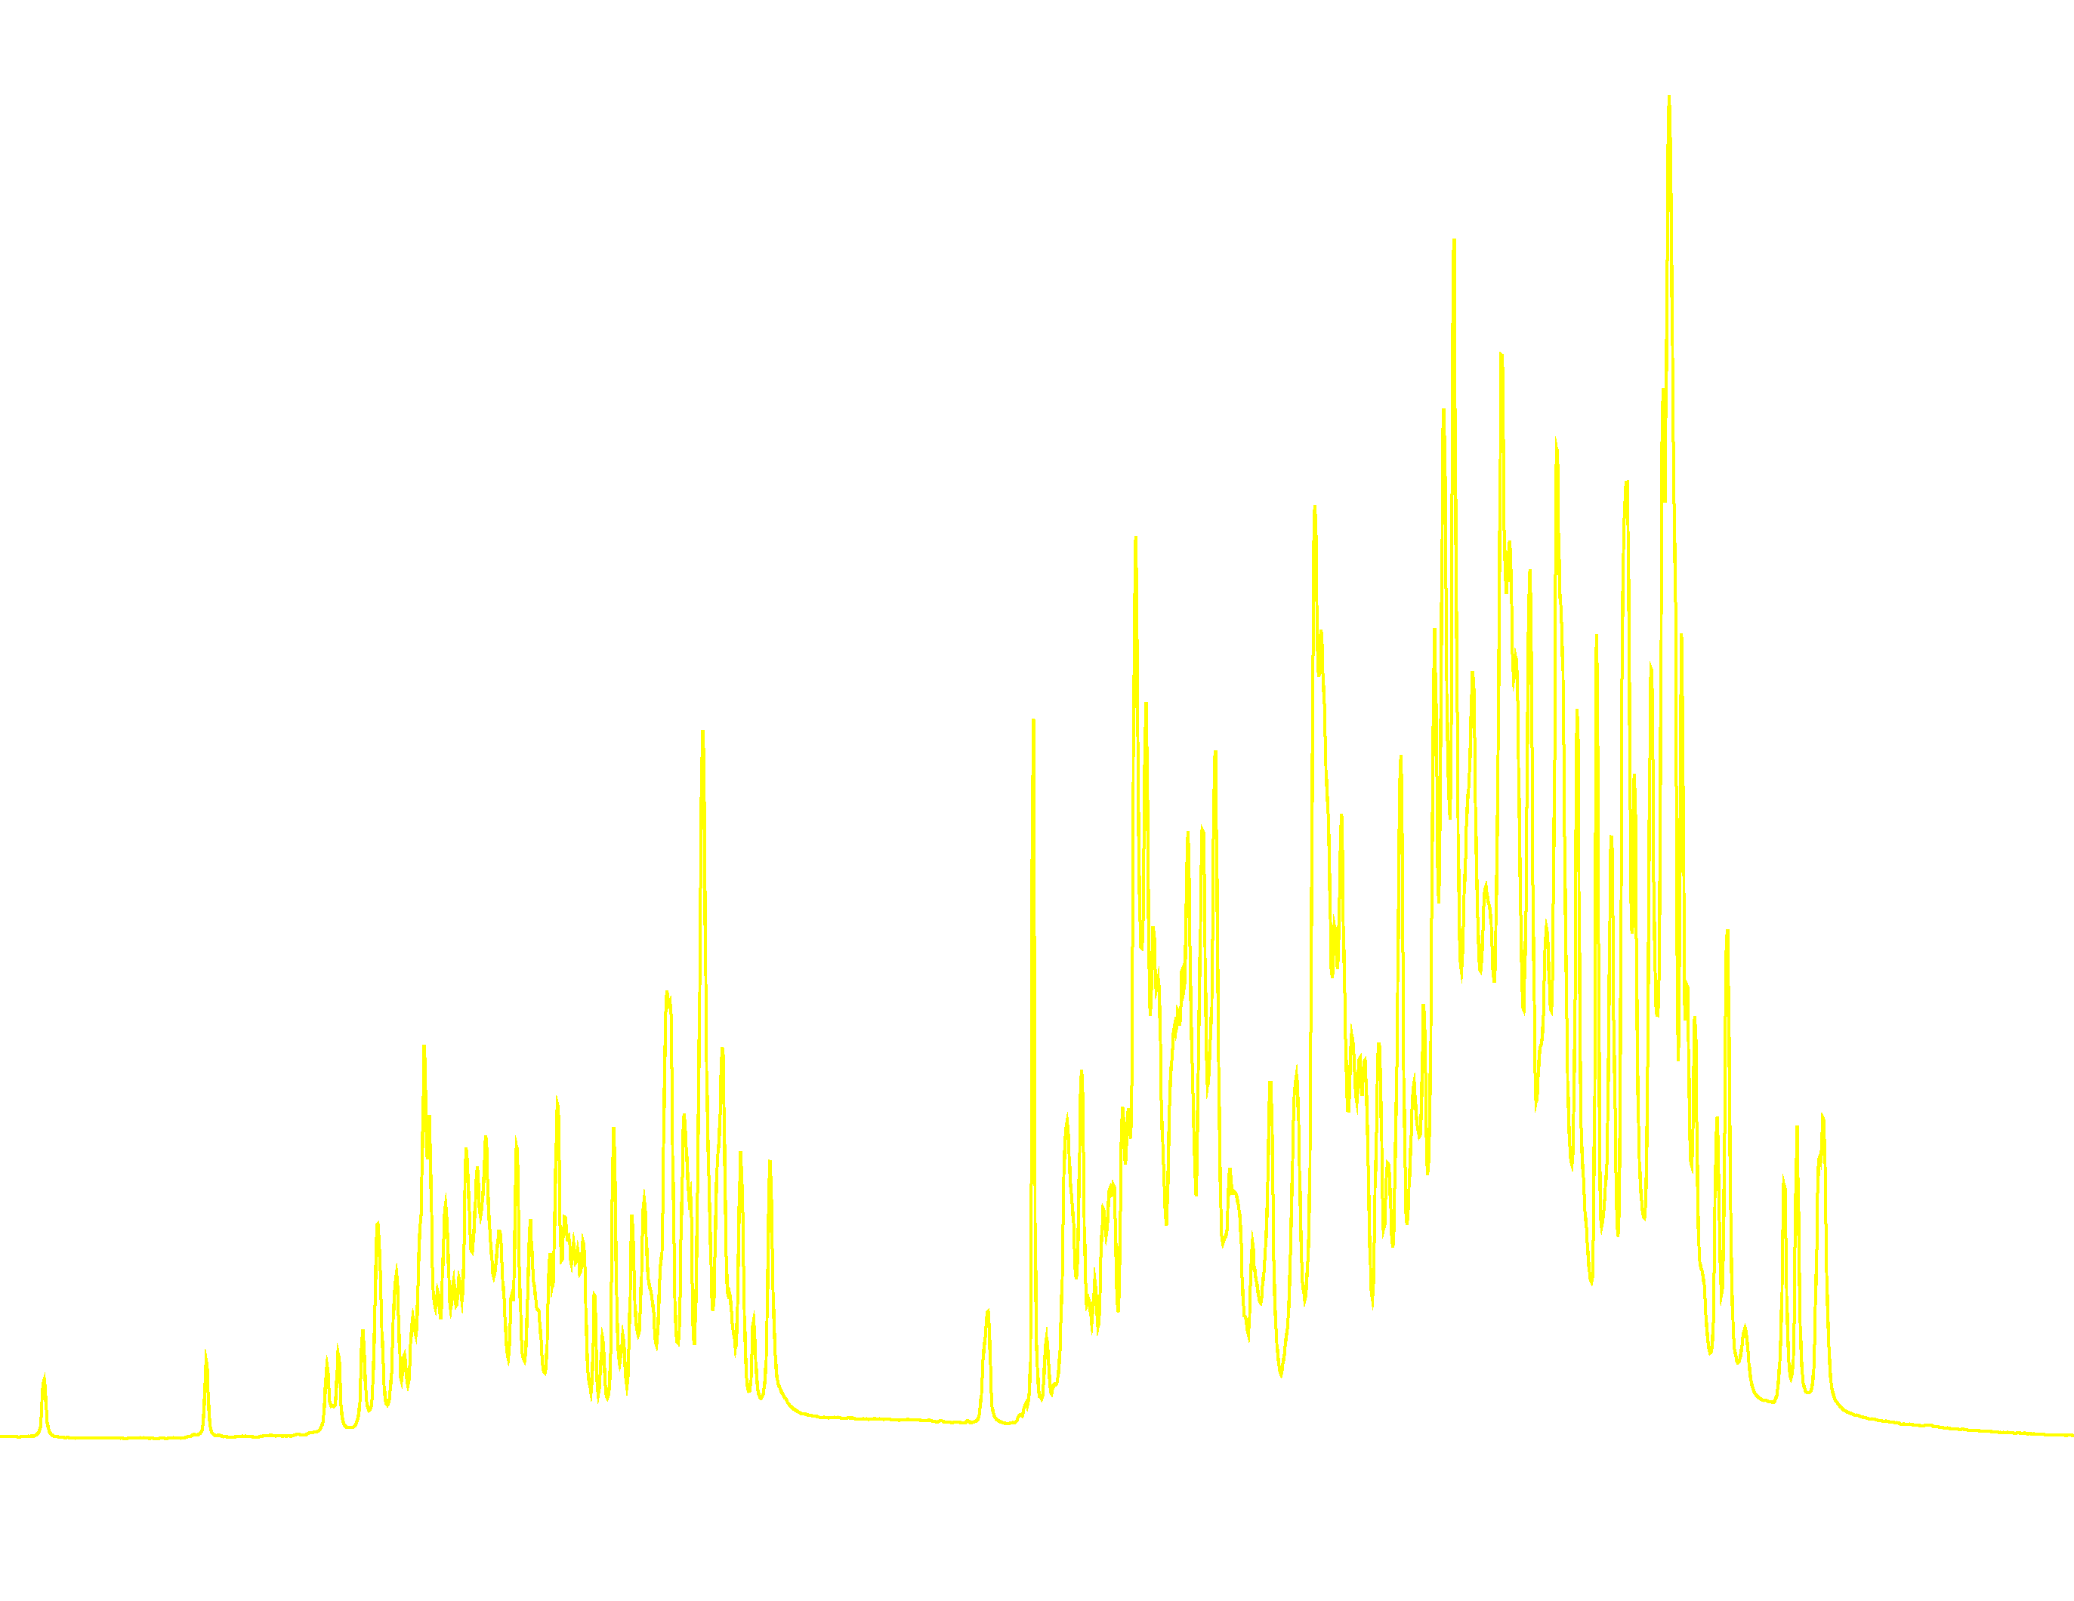
1D-NMR
1D-NMR experiment (simplest case)
Why is it not enough?
FT
S(t)
S(ω)
preparation - detection
For large proteins it is really hard to assign NMR signals and to obtain information from the spectra!
Too many peaks ⇒ Spectrum is a mess!

Slide 29

2D-NMR
Idea: adding a second dimension for improved resolution
2D FT-NMR
implementation
FT₁, FT₂
S(t₁,t₂)
S(ω₁,ω₂)
t₂ – direct domain
t₁ – indirect domain
t₂
t₁
t_{m}
Preparation evolution mixing detection
It is up to you how to design preparation and mixing: decide, what you want to know about your molecules!

Slide 30
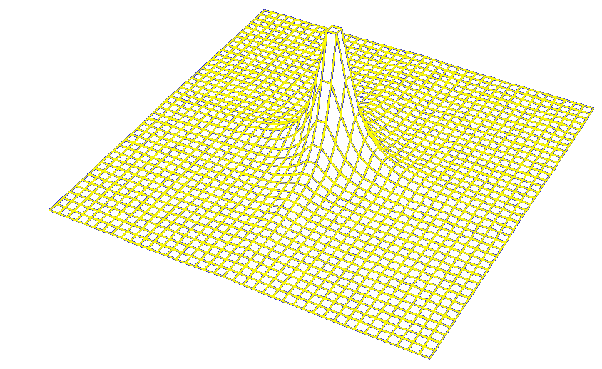

2D-NMR spectrum of a protein
Contour plot: topographical lines
In 2D the peaks become resolved

Slide 31
Direct and indirect domain
Direct time domain (acquisition, t₂): FID detection
Indirect time domain (evolution time, t₁ in 2D): FIDs are collected for different t₁ times
FT (t₂)
w₁
w₂
t₂=0
FT (t₁)
t₂
t₁
The FID depends on the evolution in t₁: the signal is 'modulated' with ω₁
For simplicity here the frequency ω is the same in t₁ and in t₂

Slide 32
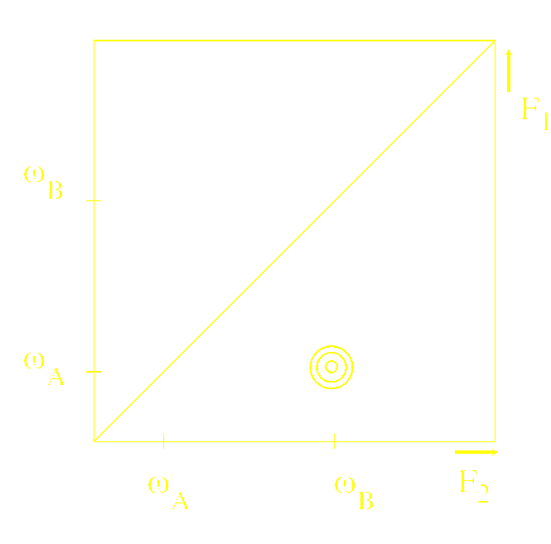
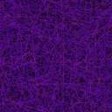

Cross-peaks and diagonal peaks
Simple example: SCOTCH experiment
Spin COherence Transfer in (photo) CHemical reactions
hν
Reaction A B with a proton at ω_{A} in A which resonates at ω_{B} in B.
t₁
l
i
g
h
t
t₂
FT
M magnetization evoilves with the frequency ω_{A} in t₁. After the light pulse, the frequency changes to ω_{B}.
FT provides a 2D spectrum with a peak at ω_{A} in F₁ and ω_{B} in F₂
The cross-peak comes from A → B and ω_{A}≠ω_{B}
When conversion A → B is incomplete the diagonal peak stays

Slide 33
Example: NOESY experiment
π/2 π/2 π/2
Cross-peaks come from NOE during the mixing period
SY = SpectroscopY
t₁
t_{m}
t₂
How does it work?
I_{1z} ⇒ –I_{1y} ⇒ –I_{1y} ⇒ –I_{1z} ⇒ –I_{2z} ⇒ I_{2y}
Transverse magnetization has gone from spin 1 to spin 2
The efficiency of transfer is (simplified)
sin(ω₁t₁) *sin(ω₂t₂)
A cross-peak will appear in the NOESY-spectrum
The cross-peak gives information on NOE ⇒ distance between the spins
The same method can be used to study chemical exchange (EXSY)
π/2_{x} t₁ π/2_{x} NOE π/2_{x}
ω₂→
Ω₁ Ω₂
ω₁→

Slide 34
Summary
NMR is working with magnetic moments of nuclei (originating from their spins)
Simple theory (Bloch equations) allows one to understand basic experiments
1D & 2D NMR concepts are introduced

