Slide 1
SIMPSON: Simulation Program for Solid state NMR
The virtual spectrometer
JMR, 147, 296-330,2000

Slide 2
NMR Workflow: 4 components
1.
2.
3.
4.

Slide 3
SIMPSON: Virtual spectrometer
Sample
Spectrometer
Pulse sequence
Spectrum
Acquisition & processing

Slide 4
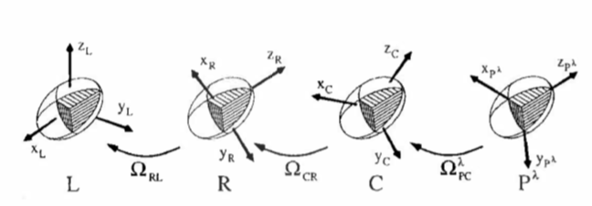
SIMPSON file (*.in)→ spinsys
Syntax
¹³C
Example
H
H
H

Slide 5
SIMPSON file (*.in) → par section

Slide 6
SIMPSON file (*.in) → pulse section
pulse ”length” “Power-Ch1” “Phase-Ch1” “Power-Ch2” “Phase-Ch2”
delay
acq
proc pulseq {} {
global par
pulse 5 5000 y 0 0
pulse 200 45000 x 35000 x
acq_block {
pulse 10000 85000 x 0 0
}
}

Slide 7
SIMPSON file (*.in) → proc section
save spectrum

Slide 8
SIMPSON Algorithms
Hamiltonian is time-dependent ( rf, MAS ) → interactions and operations
Reduced density matrix representing the state of the system
Density operator at Equilibrium ( or preparation)
Liouville-von Neumann equation
Solution to LvN
Unitary propagator
Responsible for spin dynamics
Periodic Hamitonian

Slide 9
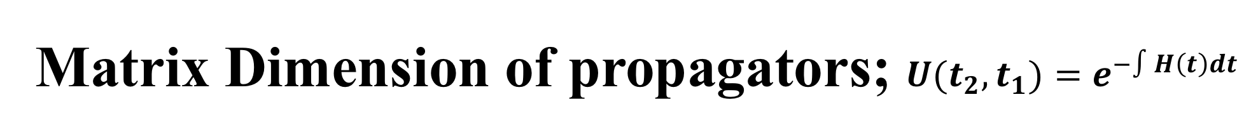
Matrix Dimension of propagators; $U(t_{2},t_{1})=e^{−∫H\left(t\right)dt}$
One spin ½
Two spin ½
Three spin ½

Slide 10
Theoretical Workshop (Day 1 & 2)
Interaction Hamiltonian (Chemical Shift, Coupling, Quadrupolar, RF)
Anisotropy ( Euler angles, Power pattern)
Homogeneous and inhomogeneous interactions
Magic-angle spinning
Time-dependent Hamiltonian and Resonances

Slide 11
Let’s get started with Simpson Exercise…

Slide 12
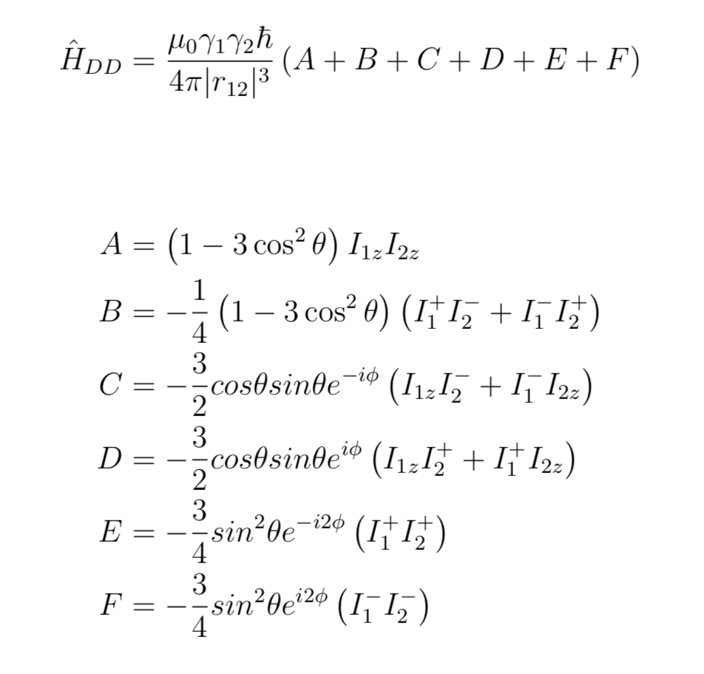
DNP Simulation: SpinEvolution
Two spin ½

